Slide 1


Health Economics Lecture #2
Topic: An Introduction to Health Economics MSMG 5240
Prepared by Jacob Smith, Trent University

Slide 2
Learning Objectives
In this lecture we will discuss:
The Circular Flow of the Economy
Analyzing Markets -Supply -Demand -Market Equilibrium
What causes prices to move?
Using supply and demand to understand stock market fluctuations.
The Demand for Insurance and Some Consumer Theory for Risk
Goal of this Lecture:
To understand what underlies fluctuations in prices and quantities in competitive markets.
Understand why risk aversion creates a demand for insurance.

Slide 3
Thinking about the Economy as a Whole
The Big Picture

Slide 4
The Economy
An economy is an area of the production, distribution and trade, as well as consumption of goods and services.
It is a place (physical or not) where where consumers and producers allocate resources and trade with each other a variety of goods.
When studying the economy, we are looking for patterns and ultimately looking to understand what are the driving forces of how society as a whole allocates resources.
Since most economies are mostly capitalist, a market centric approach to the analysis of the economy is what dominates this field.

Slide 5



The Big Picture: Circular Flow
Households
Payments for Factors of Production
Payments for Goods and Services
Goods and Services
Factors of Production
Factor Market
Product Market
Firms

Slide 6
The Big Picture: Circular Flow
Households
Households Provide Factors of Production to firms through the factor market, firms use factors to produce goods for product market. Households pay for goods in the product market Firms collect revenue and use revenue to purchase factors of production from households in factor market.
Payments for Factors of Production
Payments for Goods and Services
Goods and Services
Factors of Production
Factor Market
Product Market
Firms

Slide 7

The Big Picture: Circular Flow with Government
Households
Taxes
Subsidies
Taxes
Taxes
Payments for Goods and Services
Factors of Production
Payments for Factors of Production
Goods and Services
Subsidies
Subsidies
Government
Factor Market
Product Market
Subsidies
Taxes
Firms

Slide 8
What is a Market?
A market a place (physical or not) where buyers and sellers exchange goods and services.
These could be retail storefronts where buyers and sellers meet, vending machines or an online site like amazon or Ebay.
The a condition of transaction in a market is price, but non price bargaining can occur (i.e. such as over wait time for a service as seen in the case of medical services).

Slide 9




The Two Sides of a Market
Through bargaining they come to an agreed-upon Price
Sellers
Buyers
$
Wants products or services at lowest price possible (holding quality constant)
Wants to maximize profit

Slide 10
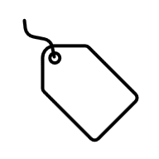
A More Realistic Story
Price is observed by buyers and sellers and they decide to accept or reject. When both parties accept this is equilibrium
Buyers
Sellers
$
Wants products or services at lowest price possible (holding quality constant)
Wants to maximize profit

Slide 11



Non Price Bargaining- Wait Time
Patient
Doctor
Looking for Medical Care.
Typically prefers sooner rather than later.
Interested in patient wellbeing and income flow as defined by schedule.

Slide 12
Where we are Heading: The Demand and Supply Model
Price
Supply
Market Equilibrium
Demand
Quantity

Slide 13
Analyzing Markets
Section 1: Supply

Slide 14
Thinking About Supply
Market supply slopes upward because as the price good rises the incentive to sell increases.
The reason why supply slopes upward has a lot to do with increasing opportunity cost associated with designating more resources to producing more goods.
Price
Supply
Quantity

Slide 15
An Individual Supply Schedule
We can think of the supply curve as a graphical representation of possible contracts that a seller is willing to accept.
Price
E
D
Willingness to Accept | Quantity available to sell
2 | 5
4 | 6
6 | 7
8 | 9
10 | 11
C
B
A
Quantity

Slide 16
A Market Supply Schedule
Seller | Willingness to Accept | Quantity available to sell
Anthony | 2 | 5
Brian | 4 | 5
Craig | 6 | 4
Dale | 8 | 2
Eli | 10 | 2
Price
E
D
C
B
A
Quantity

Slide 17
Market Supply as the Sum of Individual Supply.
P
P
P
P
+
+
=
Q
Q
Q
Q

Slide 18
Market Supply as the Sum of Individual Supply.
P
P
P
P
+
+
=
Q
Q
Q
Q

Slide 19
Analyzing Markets
Section 2: Demand

Slide 20
Thinking About Demand
Price
We can think of the demand curve as market Willingness to Pay Curve.
It is downward sloping because for a typical good, as the price gets lower there are more consumers who are willing to purchase the good.
In most cases, the lower the price the higher the quantity demanded.
Demand
Quantity

Slide 21
A Market Demand Schedule
Buyer | Willingness to Accept | Quantity Demanded
Albert | 15 | 1
Brett | 10 | 1
Cameron | 5 | 1
Price
A
B
C
Demand
Quantity

Slide 22
Market Demand as the Sum of Individual Demands.
P
P
P
P
+
+
=
Q
Q
Q
Q

Slide 23
Market Demand as the Sum of Individual Demands.
P
P
P
P
+
+
=
Q
Q
Q
Q

Slide 24
Analyzing Markets
Section 3: Market Equilibrium

Slide 25
Market Equilibrium
A Market Equilibrium is defined characterized as a situation where the quantity supplied is equal to the quantity demanded.
It is a situation where the market clears.
Everyone who is willing to pay at the market price can obtain the product and everyone who wants to sell at that price can sell.
Price
Supply
Market Equilibrium
P*
Demand
Q*
Quantity

Slide 26



Markets out of equilibrium: Price Floor
Introduction of price controls can cause a difference between supply and demand.
The first kind of control is a price floor.
It defines the minimum price which must be charged for a product.
Note that the price floor defines a minimum! If the price floor is below equilibrium, it does not bind.
Price
Supply
$$P^{F}$$
Demand
$$Q_{D}$$
$$Q_{S}$$
Quantity

Slide 27



Markets out of equilibrium: Price Ceiling
Another price control is a price ceiling.
It defines a maximum price which can be paid for a product.
In this case the quantity demanded will exceed the quantity supplied and a shortage will be created.
In the context of health economics, we can understand the fact that wait times are longer in Canada compared to the US for procedures, primarily due to this fact that fees for procedures is regulated.
Price
Supply
$$P^{C}$$
Demand
$$Q_{S}$$
$$Q_{D}$$
Quantity

Slide 28
Shifts in Supply and Demand

Slide 29
Shifts in Demand: Increase in Demand
When demand increases, it raises both the Equilibrium Market Price and Quantity.
Reasons Demand Can Shift Right (Increase):
-Increase in consumer income (for normal goods)
-Rise in price of a substitute good
-Fall in price of a complementary good
-Positive change in consumer tastes/preferences
-Increase in population or market size
-Expectations of higher future prices
-Government subsidies or tax cuts
-Successful advertising or positive publicity
Price
Supply
Demand 1
Demand 0
Quantity

Slide 30
Shifts in Demand: Decrease in Demand
When demand decreases, it decreases both the equilibrium market price and quantity.
Reasons Demand Can Shift Left (Decrease): -Decrease in consumer Income (for normal goods). -fall in the price of a substitute good. -Rise in the price of a complementary good. -Negative change in consumer tastes/preferences. -Decrease in population or market size. -Expectations of lower future prices. -Higher taxes on consume incomes. -Loss in popularity or negative publicity,
Price
Supply
Demand 0
Demand 1
Quantity

Slide 31
Shifts in Supply: Increase in Supply
When supply increases, it decreases the equilibrium market price and raises quantity.
Reasons Supply Can Shift Right (Increase):
Fall in production costs (e.g., cheaper raw materials)
Technological improvements
Government subsidies
Favorable weather (for agriculture)
Entry of new firms into the market
Expectations of lower future prices
Reduction in taxes or regulations
Price
Supply 0
Supply 1
Quantity

Slide 32
Shifts in Supply: Decrease om Supply
Supply 1
When supply shifts to the left, it raises the equilibrium market price and decreases quantity.
Reasons Supply Can Shift Left (Decrease):
-Rise in production costs (e.g., higher wages etc)
-Technological setbacks or production disruptions
-Withdrawal of subsidies
-Unfavorable weather or natural disasters
-Exit of firms from the market
-Expectations of higher future prices (holding back supply)
-Increase in taxes or stricter regulations
Price
Supply 0
Quantity

Slide 33
Applications of the Supply and Demand Model
Using Supply and Demand to Understand Stock Market Fluctuations

Slide 34
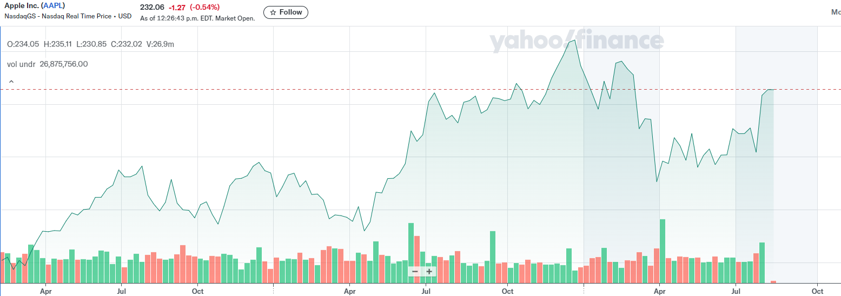
Some Stock Market Data

Slide 35
What is causing markets to move?
Change in Price | Change in Quantity (Volume) | What is Happening
Increase | Increase | Demand has increased (Right shift in Demand curve)
Increase | Decrease | Supply has decreased (Left Shift in Supply Curve)
Decrease | Increase | Supply has increased (Right Shift in Supply curve)
Decrease | Decrease | Demand has Decreased (Left shift in Demand Curve)

Slide 36
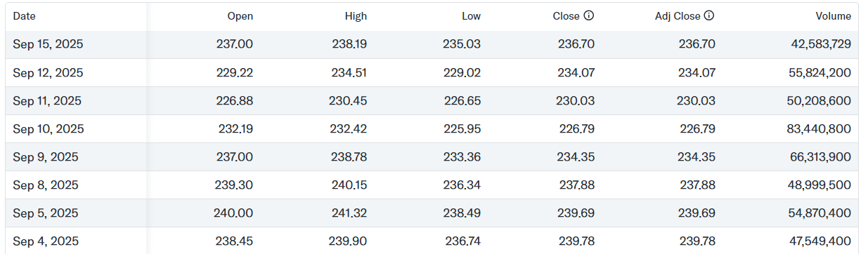
Observing Shifts in Data

Slide 37
The Demand for Insurance and Some Consumer Theory for Risk
An Overview

Slide 38
Why Insurance?
People buy insurance to protect themselves from the risk of financial losses.
These losses can be due to sudden changes in individual’s health, accidents or job loss.
Insurance minimizes the loss associated with adverse events.
The demand for Insurance comes from the fact that people are Risk Adverse (meaning that they dislike risk and prefer certainty)

Slide 39
How Risk Aversion Creates Insurance Demand
Utility U(X)
Utility is defined as the satisfaction a consumer gets from consuming a good.
A key result in consumer theory is that consumers have a Diminishing Marginal Utility from consumption.
This means that the additional satisfaction a consumer gets from consuming more and more of a good is decreasing.
Graphically this implies that the total utility from consumption is a concave function.
Good X

Slide 40




How Risk Aversion Creates Insurance Demand
Utility U(X)
Consider two points on this curve A and B.
Here A has a lower level of utility compared to B because less of A is consumed.
A consumer with these preferences get a higher utility from B compared to A.
B
$U(x_{B})$
A
$U(x_{A})$
$$x_{A}$$
$$x_{B}$$
Good X

Slide 41



How Risk Aversion Creates Insurance Demand
Utility U(X)
Suppose instead that consumers are offered a gamble where they have a 50-50 chance of getting $x_{A}$ or $x_{B}$.
In this case we think of them consuming an average bundle $\overline{x}$ and obtain utility $U\left(\overline{x}\right)$
B
$U(x_{B})$
$$pU\left(x_{A}\right) \\ +\left(1−p\right)U(x_{B})$$
A
$U(x_{A})$
$$x_{A}$$
$$\overline{x}$$
$$x_{B}$$
Good X

Slide 42

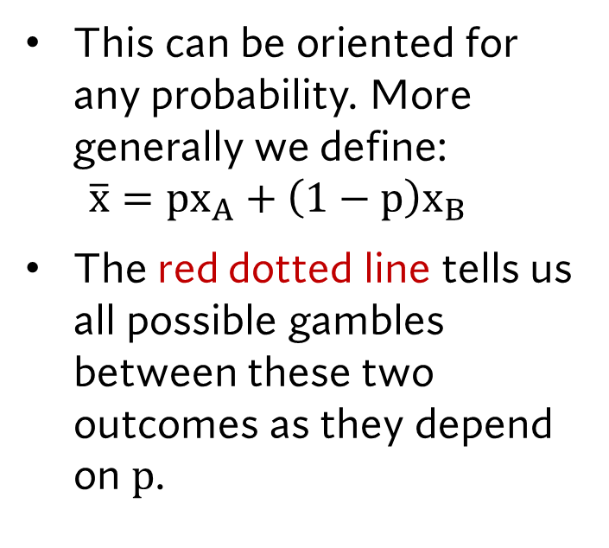
How Risk Aversion Creates Insurance Demand
Utility U(X)
This can be oriented for any probability. More generally we define: $\overline{x}={px}_{A}+\left(1−p\right)x_{B}$
The red dotted line tells us all possible gambles between these two outcomes as they depend on $p$.
B
$U(x_{B})$
$$pU\left(x_{A}\right) \\ +\left(1−p\right)U(x_{B})$$
A
$U(x_{A})$
$$x_{A}$$
$$\overline{x}$$
$$x_{B}$$
Good X

Slide 43
How Risk Aversion Creates Insurance Demand
Utility U(X)
What's noticed right away is that the level of utility had for any gamble will have a lower utility compared to a certain level of consumption.
B
$U(x_{B})$
$$pU\left(x_{A}\right) \\ +\left(1−p\right)U(x_{B})$$
A
$U(x_{A})$
$$x_{A}$$
$$\overline{x}$$
$$x_{B}$$
Good X

Slide 44


How Risk Aversion Creates Insurance Demand
Utility U(X)
What is seen here is that consumers can be provided with less of a good and still obtain the same level of utility as the gamble.
$x_{CE}$ is the “certainty equivalent” amount of good X where consumers are indifferent between the gamble and consuming that bundle directly.
Mathematically the certianty equivalent is one where: $U\left(x_{CE}\right)=pU\left(x_{A}\right)+\left(1−p\right)U(x_{B})$
B
$U(x_{B})$
$$pU\left(x_{A}\right) \\ +\left(1−p\right)U(x_{B})$$
A
$U(x_{A})$
$$x_{A}$$
$$x_{CE}$$
$$\overline{x}$$
$$x_{B}$$
Good X

Slide 45




How Risk Aversion Creates Insurance Demand
Utility U(X)
Risk aversion is detectable when: $U\left(x_{C}\right)>pU\left(x_{A}\right)+\left(1−p\right)U\left(x_{B}\right)$ or where $x_{CE}<\overline{x}$
In plain English this is where the utility from a certain outcome is higher than its Expected Utility as defined by the probability weighted average OR when the certainty equivalent is less than the expected average outcome $\overline{x}$
B
$U(x_{B})$
$U(x_{C})$
$$pU\left(x_{A}\right) \\ +\left(1−p\right)U(x_{B})$$
A
$U(x_{A})$
$$x_{A}$$
$$\overline{x}$$
$$x_{B}$$
$$x_{CE}$$
$${=x}_{C}$$
Good X

Slide 46
Other Risk Preferences
Utility U(X)
Risk Neutrality -Constant Marginal Utility
Utility U(X)
Risk Loving -Increasing Marginal Utility
Good X
Good X

Slide 47

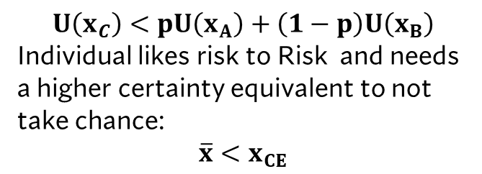


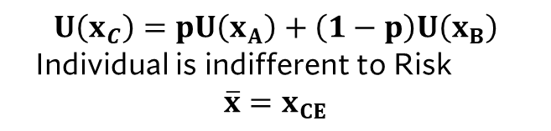










Other Risk Preferences
Question: What about risky choice here?
$$U\left(x_{C}\right)<pU\left(x_{A}\right)+\left(1−p\right)U\left(x_{B}\right)$$ Individual likes risk to Risk and needs a higher certainty equivalent to not take chance: $$\overline{x}<x_{CE}$$
Utility U(X)
$$U\left(x_{C}\right)=pU\left(x_{A}\right)+\left(1−p\right)U\left(x_{B}\right)$$ Individual is indifferent to Risk $$\overline{x}=x_{CE}$$
Utility U(X)
$U(x_{B})$
$U(x_{ B})$
$U\left(\overline{x}\right)=U\left(x_{CE}\right)$
$U\left(\overline{x}\right)=U\left(x_{CE}\right)$
$U(x_{A})$
$U(x_{A})$
$$x_{A}$$
$$\overline{x}=x_{CE}$$
$$x_{B}$$
Good X
$$x_{A}$$
$$\overline{x}$$
$$x_{CE}$$
$$x_{B}$$
Good X

Slide 48
Learning Objectives
In this lecture we will discuss:
The Circular Flow of the Economy
Analyzing Markets -Supply -Demand -Market Equilibrium
What causes prices to move?
Using supply and demand to understand stock market fluctuations.
The Demand for Insurance and Some Consumer Theory for Risk
Goal of this Lecture:
To understand what underlies fluctuations in prices and quantities in competitive markets.
Understand why risk aversion creates a demand for insurance.

